Slide 1




Your trading expert
Proudly presented by Duy, Mabel, Aditya, Gerry, Tong

Slide 2

Team Members
Dao Duc Duy : Architecture Designer
Gerry Anggacipta : Database Developer /QA
Sambamoorthy Aditya : Strategy Management/ Low Touch Trade
Mabel Foo : User Interface Designer
Liu Tong : Production Support

Slide 3
Architecture
Market Data Provider
Market Data View
Market Data ViewModel
Strategy Engine
QueueManager
Strategy View
Strategy ViewModel
MarketDataManager
Stock
StrategyManager
Trade View
Trade ViewModel
Strategy
TradeManager
Trade
PortfolioManager
Portfolio/Performance View
Portfolio Perf.
View Model
PortfolioEntry
Data Access Layer
View
ViewModel
Model

Slide 4
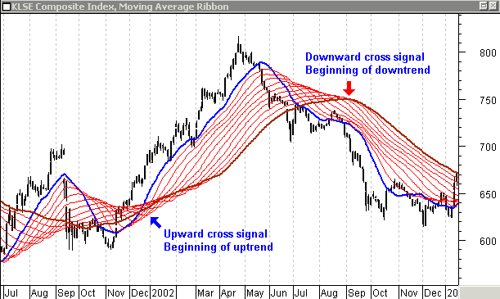
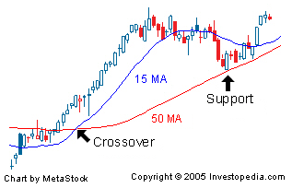
Strategies

Slide 5
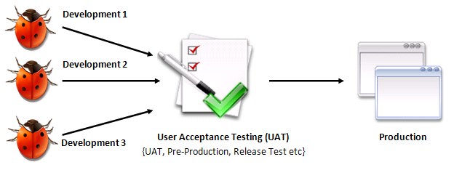
Development Process

Slide 6
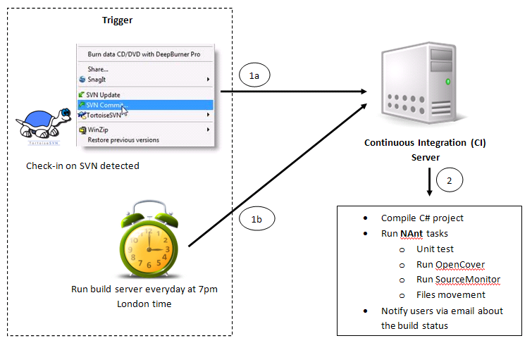
Integration Control
Cruisecontrol.NET

Slide 7
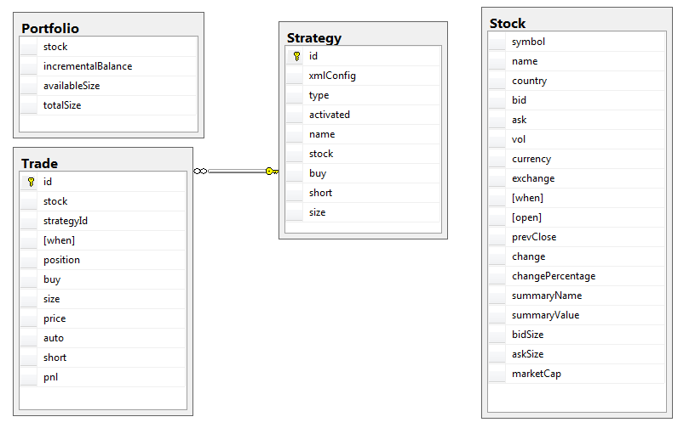
Database Schema
Source tool: NDepend

Slide 8
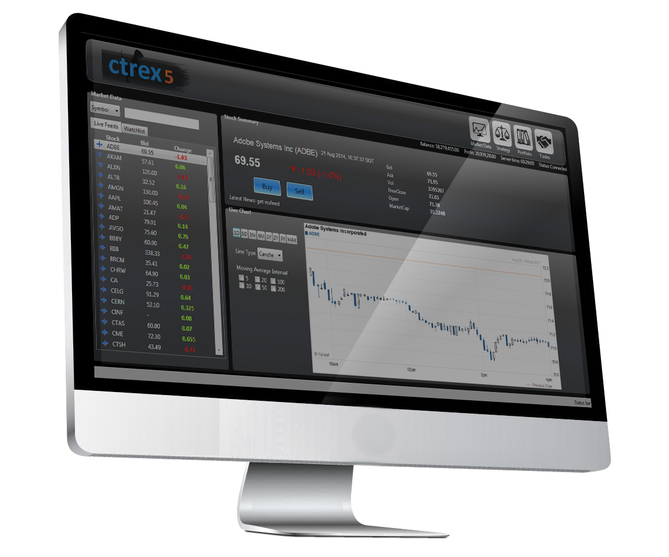
Demo

Slide 9
Production Support
What need to do:
Production Support Budget –Might high
Full Application Documents
Evidence of completed sign offs
Monitoring Setup
Training Calendar Setup
Install Release Notifications/Pre Production Release Audit
Post Implementation Review
What have been done:
All the codes
Testing on basic functions
Configuration files
Design documentation
Infrastructure Impact (Log files)
Hardware back out (Code Server)

Slide 10
PTO
Not ready to deployment
But promising
Need minor changes
Use Citi Internal Engine to feed the data

Slide 11
Thank you!

